Slide 1
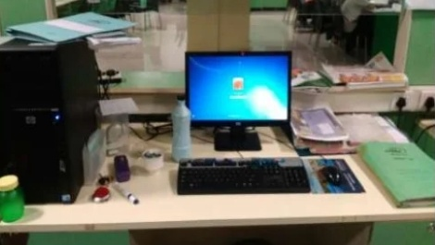
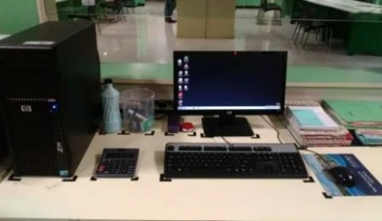
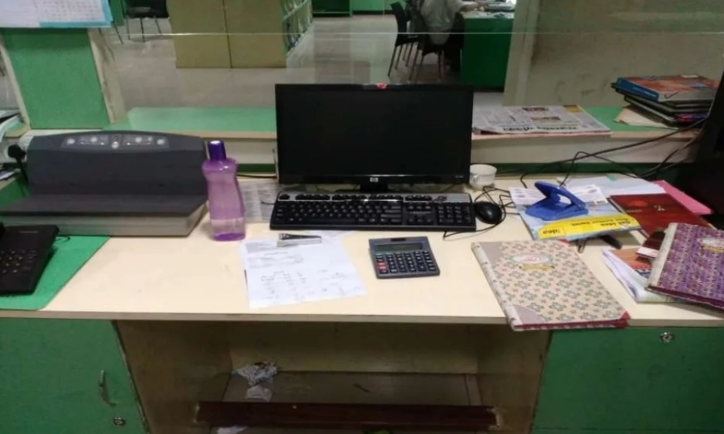
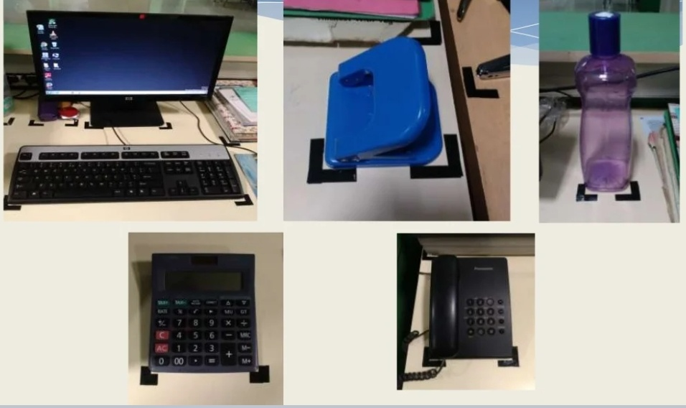
5S Assignment
Name: Rahebul Islam Shuvo 5S Category: Standardize | STARTED ON: 8 June 2022 |  | FINISHED ON: 13 June 2022
BEFORE IMPROVEMENT |  | AFTER IMPROVEMENT
ACTION TAKEN: Standardized the working area Defined place for each items
BENEFITS: Easy to find things at workplace No unwanted mess at workplace Clean and pleasant Environment Create little bit extra space Self Discipline

